Slide 1
OOP with C++
Cemalettin Cem Belentepe

Slide 2
Syllabus
Week | Topic
1 | C++ vs C
2 | Introduction to Classes
3 | Operator Overloading
4 | Object Constructor
5 | Object Initialization
6 | Inheritance
7 | Polymorphism and Virtual Functions
8 | Templates
9 | Error Handling
10 | Smart Pointers and move semantics
11 | Introduction to the C++ Standard Template Library

Slide 3
C++ vs C
OOP +
Namespaces
References
Function and operator overloading
Exceptions
Templates

Slide 4
Namespace
Decleration
Usage
Using
Declerating outside
Extending
Nested

Slide 5
Reference
What it is?
Where to use?

Slide 6
Argument Passing
Pass by copy, pointer, referance

Slide 7
Function Overloading
Example

Slide 8
Object Oriented Programming
Usage
OOP vs Procedural

Slide 9
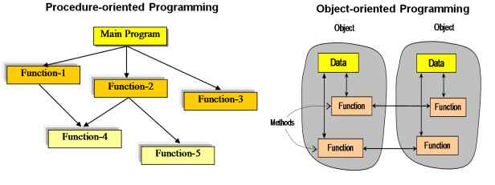
POP vs OOP

Slide 10
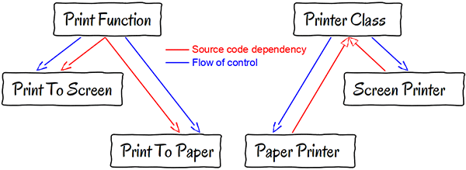
POP vs OOP

Slide 11
Class
Member
Access modifier

